Slide 1
Incorporating SDH into Problem-Based Learning
Thuy Bui, MD and Iman Hassan, MD, MS
University of Pittsburgh and Montefiore Medical Center
ChangeMedEd 2019
Chicago, IL

Slide 2
Medical Education in Social Determinants of Health
Drip feed: didactics, service-learning, home visits…
Weaving and integrating: basic sciences, health systems science, clinical clerkships…

Slide 3
Re-examining the dominant narratives
Building narrative power for racial justice and health equity -
Open Society Foundations

Slide 4
A guide for revising teaching cases: attention to race and culture
A practical, structured, and evidence-based guide for revision of existing teaching cases
To improve the delivery of critical content about race, culture, structural inequalities and health disparities through case-based teaching
6 themes describing common mistakes/pitfalls in the presentation of race and culture in Aquifer teaching cases
Examples: avoid portraying patients of color/minority status as having unhealthy behaviors and as being uninsured…
Krishnan A, et al. Acad Med. 2019;94:550-555

Slide 5
Methods
PBL cases from course directors in the Organ Systems Block at UPSOM
Infectious diseases, pulmonary, rheumatology, hematology, nephrology, neuroscience, reproduction, cardiology
Reviewed by 2 faculty with expertise in SDH and medical education
Sociodemographic identities
Scientific evidence linking conditions with psychosocial determinants
Facilitator’s guide questions and discussion
Include rationale and references
Embedded course evaluation

Slide 6
Example: insert in the discussion of nicotine replacement therapy
Nicotine replacement therapy (NRT) reduces withdrawal symptoms and is available in a variety of forms – gum, patch, inhaler, and nasal spray. The patch is the most convenient and most popular. Bupropion is an atypical antidepressant that reduces the urge to smoke by unknown mechanisms. Varenicline (Chantix ®) is a partial agonist for nicotinic acetylcholine receptors in the brain. Studies have shown that varenicline is the most effective pharmacologic therapy for smoking cessation.
ADD
Smoking explains about 1/3 of the difference in life expectancy between lower and higher socioeconomic status (SES) groups (Gregoraci, 2017). In the US, people living below the poverty level and people having lower levels of educational attainment have higher rates of cigarette smoking than the general population (CDC, 2014 Surgeon General’s Report). Smoking cessation interventions such as behavioral modification and pharmacotherapy tend to differentially benefit individuals from higher SES groups. For lower SES smokers, it may be necessary to address their disadvantaged living conditions such as financial stress, unemployment, income insecurity, living in high-pollution neighborhoods.

Slide 7
How to enhance existing PBL cases
Explore group differences, racial disparities
Discussion of treatment nonadherence as s/s of psychosocial influences
Encourage social needs screening and related healthcare interventions
Explore cultural beliefs; modify and adapt for patients with limited English proficiency
Include impacts of housing and environmental factors including occupational exposure
Highlight interaction between social disadvantage and stress
Explore how behaviors are shaped by social forces or contextual factors
Healthcare access: uninsured, underinsured and healthcare navigation/coordination of care

Slide 8
Highlight racial disparities
A 20-year-old woman presents with 4 months of pain and stiffness in the MCPs and wrists. Symptoms are worse in the morning lasting for 1 hour and improve with movement...On exam, wrists are swollen and tender...ESR 48; RF is positive at 105, anti-CCCP is >250. X-rays show periarticular osteopenia but no erosions.
What is the significance of lab testing in dx of RA?
What are the typical features seen in this pt that are helpful in making the dx of RA?
A 30-year-old patient with HTN and ESRD/HD is being evaluated for renal transplant…
So many potential discussion questions…
Delay in referral
Fewer AA living donors
Mistrust about equity in the organ-allocation process
Misconceptions about risks, etc.
Add to discussion questions: Health outcomes for persons with RA have improved significantly with the introduction of biologic therapies...why do you think worse outcomes are still being observed among certain groups, such as African Americans and Hispanics relative to their White counterparts?
Notes:
Disparities may be a result of events that preceded access to subspecialty care, poor adherence, or healthcare delivery system differences
Epidemiology, risk of exposure, degree of susceptibility affecting course and outcome of a disease

Slide 9
Nonadherence – root causes
A 38-year-old man returns to discuss recent test results (CD4 150 HIV RNA of 75,000 copies/ml). He is currently taking Bactrim, tenofovir-emtricitabine and darunavir-ritonavir daily.
What strategies have been shown to improve adherence?
What else?
Besides cost, transportation and health literacy, what other social barriers should be considered in addressing medication adherence?

Slide 10
Screen and address social needs
Add: due to the family’s difficulty finding transportation
Adapted from Aquifer’s pediatric cases
John is brought in by his mother for his 18-month-old well child exam. The family is new to your clinic and John’s prior doctor’s visits have all been at the local health department. You have no medical records to review.
John’s mother voices concern that John does not seem to be talking or using words and that he has been “more difficult to deal with than his older sister at this age.” She goes on to say, “I don’t think he hears very well; he does not come to me when I call his name.” She mentions that John does not walk yet, choosing mostly to just “scoot around,” and that he does not say specific words but babbles, saying “mamama” and dadada.” He is still drinking from a bottle because he does not seem to understand how to use a cup….

Slide 11
Screen and address social needs
A 73-year-old woman was admitted to the CCU with complaints of shortness of breath, fatigue and dizziness. She has a long history of HTN and CAD. Physical exam reveals O2 sat 86% BP 94/60, P 120, RR 32, bilateral rales throughout both lungs, irregular heart rate, JVD, 4+ pitting edema of both ankles, etc.
What are your differential diagnosis?
What data in the history support the diagnosis?
Add:
She lives independently and reports that her diet consists primarily of canned soup and other packaged food.

Slide 12
Patients from diverse ethnic/cultural backgrounds
A 66 year old man presents to the ED complaining of progressive weakness and fatigue. The patient states that the onset of fatigue began 6 months previously. He denies any chest pain with exertion, any prior history of cardiac, pulmonary problems or anemia. PMHx is remarkable for a gun shot wound to the abdomen 10 years previously. He is presently taking no medication and has no allergies. He drinks 3-6 beers a day. He used to work as a farmer. He states that his diet includes meats and vegetable and denies a history of chronic diarrhea. PE is significant for pale conjunctiva, smooth appearing tongue and ecchymoses in the lower extremities. Lab: Hb 7, MCV 120, RDW 20%; WBC 2.5; Platelets 50K. Smear showed oval macrocytes, granulocytes and hypersegmentation of the nuclei. B12 125; folate/RBC folate normal; LDH 1050; haptoglobin < 9
Questions for discussion:
How would you characterize his anemia?
Why did it take 10 years for the patient to become deficient in B12?
What are the causes of B12 deficiency?
What are the causes of pancytopenia?
Some studies suggest that elderly Hispanics have lower B12 level than neighborhood-matched non-Hispanic whites. What dietary source might play a role to account for this difference? (Kwan, 2002)
What additional dietary history would you consider?
Notes:
https://academic.oup.com/jn/article/132/7/2059/4687434
The high prevalence of low vitamin B-12 status in elderly Hispanics appears largely attributed to inadequate intake. As in other populations, sources of unbound vitamin B-12 such as supplements and fortified cereal appear to be protective. Dietary intervention programs targeted to the Hispanic population should promote these vitamin B-12 sources.

Slide 13
Housing and neighborhood
A 72-year-old woman was found down on her living room floor by her niece. She remembered fixing dinner and watching the evening news on TV when she noticed headache, blurry vision and lightheadedness. Pulse oximetry O2 sat was 91%, improved to 96% with O2 on transport to the ED. ABG was 7.4/40/95 in the ED. Oxygen-hemoglobin saturation curve is shown below...
How is the affinity of hemoglobin for CO compared to O2?
This patient relies on an old kerosene fueled space heater in the winter. What additional questions about her housing situation would you like to know. What could we do as healthcare providers to prevent another episode?
Notes:
This should be followed with questions about housing, weatherization and energy assistance programs

Slide 14
Stress and biology of disadvantage
A 15-year-old boy who had been overweight since the age of 6 months was referred to an adolescent obesity clinic for further management of his obesity. The patient had no hx of developmental delay or abnormal growth velocity. Previously tested negative for Prader-Willi syndrome and the melanocortin-4-receptor gene mutation. He had made numerous attempts at weight loss in the past but unsuccessful. BMI 52.3kg/m2, a waist circumference of 156 cm, BP 130/85 mmHg and severe acanthosis nigricans in the cervical and axillary skin folds. Investigations....
What would you like to know about his parents and home life?
Notes:
Parent stressors is related to child obesity through child fast-food consumption
The association between stress in early life and obesity and overweight in adulthood is well established. Major sources of early life stress include adverse childhood experiences (e.g., abuse), poverty, food insecurity and poor relationships with primary caregivers. Exposure to chronic and acute early life stressor can disrupt the biological stress regulation system, change the structure of regions of the brain responsible for emotion regulation, etc. Obesity interventions should also consider the nature of stress experienced by parents of different racial/ethnic and socioeconomic backgrounds
Social inequalities based on race-ethnic group membership; unhealthy lifestyle, high risk health behavior, social networks; perceived discrimination;
chronic trauma and sexual health outcomes; perceived stress and depression
Racial trauma and substance use; insomnia, cardiovascular diseases, stigma and minority stress (LGBT); social stressors and chronic inflammation; social disadvantage and DNA methylation, increased loss of telomeres
Obesity and smoking, future orientation, attitudes toward prevention, regular exercises and eating fruits and vegetables

Slide 15
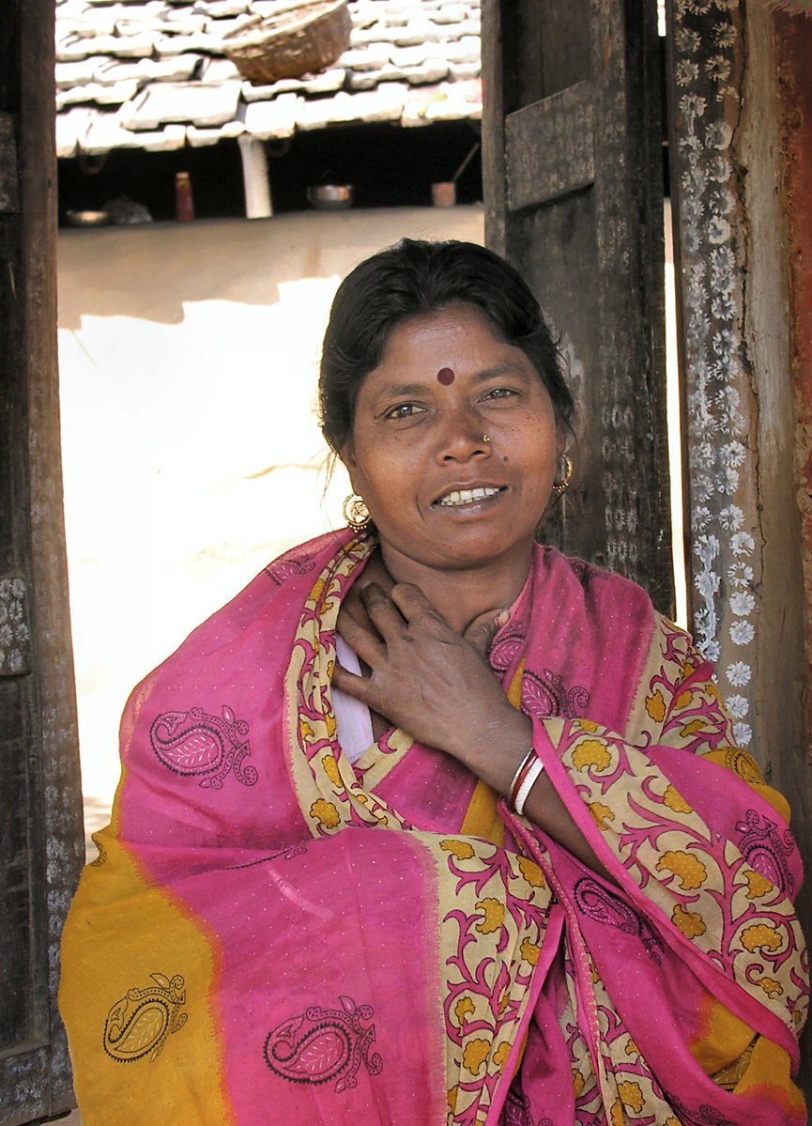
Health behaviors and social determinants
A 38-year-old G4-2-2-4 is counseled on contraception. She is married and is only sexually active with her husband. She experienced preeclampsia at her last pregnancy, and now her BP is consistently in the 150/90 range on multiple office visits and ambulatory monitoring. Patient does not want to get pregnant.
Which contraceptive options are contraindicated in this patient and which options are safer?
She declines all options including mini pill, medroxyprogesterone acetate, Mirena or copper IUD and etonogestrel implant. What could be underlying her decision? How do you explore social barriers and structural constraints influencing the use of contraception?
Notes:
Misperceptions about the health effects of family planning, men's opposition to contraceptive use, structural obstacles, etc.
Intersectionality—the overlapping categories of social identities such as gender, race, class, disabilitiy status, sexual orientation and related structures of oppression and discrimination. A shared history of daily experience of discrimination among patients of color might negatively influence their health outcomes and feelings about healthcare systems. This may be expressed as avoiding care, mistructing healthcare providers, or not following recommended treatments.

Slide 16
Healthcare access, navigation and cost
Mr. S is a 48-year-old man with hypertension. He stopped taking telmisartan last month and BP today is 174/100
Mrs. C is a 62-year-old man with newly diagnosed multiple myeloma....Emergency Medicaid was granted for him to get treatment....
Prices for oral antineoplastic medications have been escalating (Shih, 2017)
Insurance type and regional income are associated with MM survival (Chamoun, 2019)

Slide 17
Small group work (10 minutes)
Review the case of a patient with asthma
Each group has a different task to SDH-enhance the case
Add one follow-up or probing question
Discuss possible answers to the probing question
Nominate a spokesperson

